Slide 1


Dual Port RAM Implementation on FPGA with verilog and system verilog - Driven Testbenches
Mid-Review 1/2/3
GITAM (Deemed-to-be) University
Major Project
Project ID: V16
AY 2021-25
Project Team:
N Keerthi(BU21EECE0100410)
C SanthiPriya(BU21EECE0100367)
Pranitha M(BU21EECE0100336)
Department of Electrical Electronics and Communication Engineering
Project Mentor:
Dr.Arun Kumar Manoharan
Project In-charge:
Dr. Ambar Bajpai
www.gitam.edu

Slide 2
Objective and Goals
Objective
1. Optimize Resource Utilization: To Efficiently utilize FPGA hardware resources during the design and implementation process, ensuring minimal resource usage without compromising performance.
2. Facilitate Comprehensive Verification: To Use Verilog/SystemVerilog-driven test benches to validate the design under various operational conditions, ensuring robustness and functionality in real-world applications.
3.To Support Independent Addressing: Allow each port to access different memory locations concurrently, providing flexibility and efficiency in complex data management tasks.
4.To Ensure Data Integrity: Develop mechanisms to handle read-write conflicts, ensuring consistent data integrity during simultaneous access to the same memory location.
Goals
Scalability: Develop a design that can be easily scaled for larger memory sizes or adapted for more advanced FPGA architectures.
Enhanced Verification: Utilize SystemVerilog's advanced features, such as constrained random verification and functional coverage, to thoroughly test and validate the design.
Documentation and Reporting: Provide clear documentation, including design methodology, simulation results, and insights for future enhancements.

Slide 3
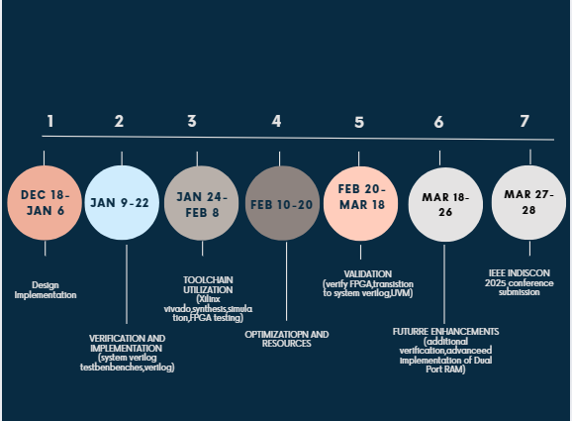
Project Plan (Clearly mention milestone for objectives under each reviews)
Ghant Chart - Milestones and Activities

Slide 4
Literature Survey (Improved post minor project)
Key Publications
Design and Verification of Dual Port RAM using System Verilog Methodology - 2019
Design and Implementation of Synchronous Dual Port Memory - 2024
Verification Environment of Dual Port RAM - 2019
Key Resources – Whitepaper| Application Notes | Datasheet| Others
Design and Verification of a Dual Port RAM Using UVM Methodology - paper
Understanding Asynchronous Dual-Port RAMs - notes
Existing Implementations – Products| Opensource| GitHub etc
1.SystemVerilog Dual-Port RAM by KennethWilke:
GitHub Link: Dual port-RAM
2.Dual-Port RAM by yashgupta26
Github Link: DPRAM

Slide 5
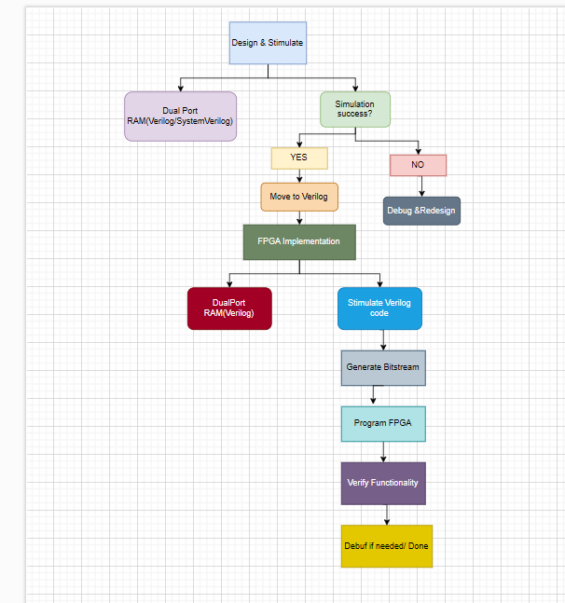
Architecture

Slide 6
Use Cases & Testing
Use Cases:
Communication Systems: Ideal for buffering and queuing in high-speed networks, where concurrent data access is critical.
Multi-Core Processors: Enables efficient data sharing between processors or cores in parallel computing environments.
FPGA-Based Prototyping: Provides a reusable and scalable memory design for various FPGA-based development platforms.
Test Cases :
Basic Read/Write Operations:
Verify individual read and write operations for both ports.
Test for different data widths and memory addresses.
Simultaneous Access:
Test simultaneous read and write operations at different addresses.
Check for data consistency when both ports access the same address.
Concurrent Operation:
Stress test with random read/write operations on both ports.
Reset and Initialization:
Verify correct memory initialization after a reset signal.
Check whether all memory locations are cleared or loaded with default values.

Slide 7
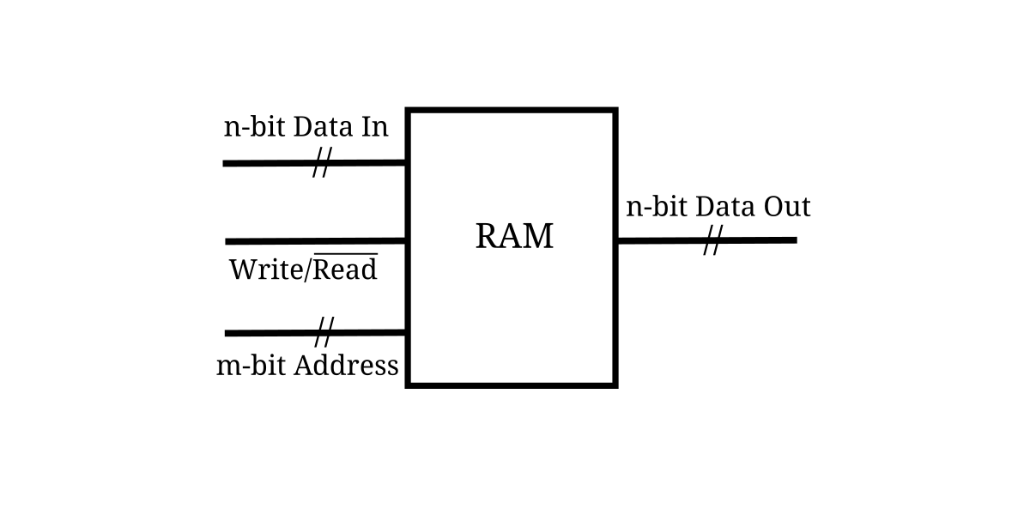
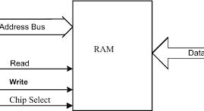
RAM (Random Access Memory)
RAM is a type of computer memory that is used to store data that is actively being used or processed by the CPU. It's called "random access" because any byte of memory can be accessed without touching the preceding bytes, allowing for fast data retrieval. RAM is volatile memory, meaning it loses its contents when the power is turned off.
Key Points about RAM:
Volatility: RAM loses its data when the device is powered off.
Speed: It's much faster than storage devices like SSDs or hard drives.
Types: Common types include DRAM (Dynamic RAM) and SRAM (Static RAM).
Capacity: The amount of RAM determines how much data can be processed at once. More RAM allows for more applications to run simultaneously and can improve system performance.
Use in Computing: RAM is used by the operating system and applications to store and access data quickly. When your computer runs out of RAM, it may use a portion of the hard drive as "virtual memory," which is slower.

Slide 8
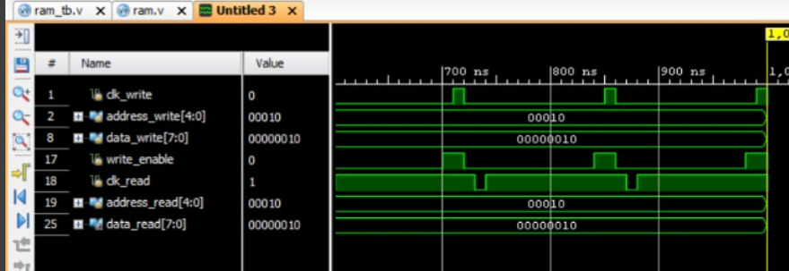
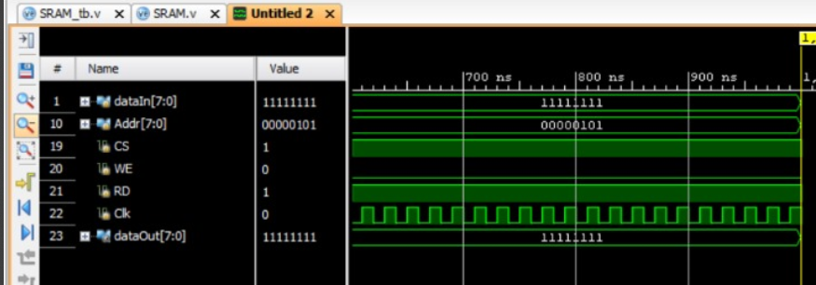
Implementation and Results – Iteration 1
Iteration : Results(Verilog)
RAM output waveform
SRAM waveform

Slide 9
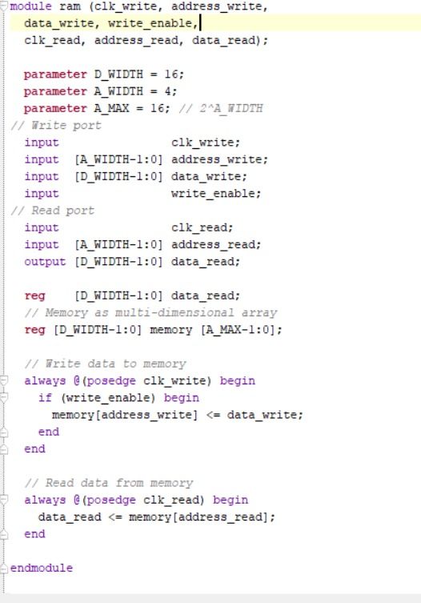
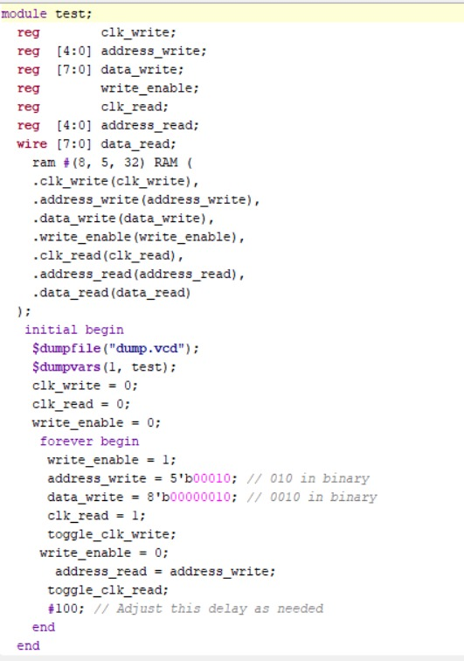
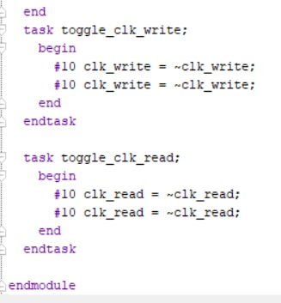
Implementation and Results – Iteration 3
Iteration : Results + Validation against the use cases and test cases
RAM Verilog code Testbech

Slide 10
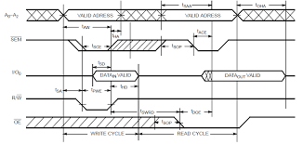
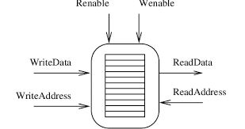
DUAL PORT RAM
Dual-Port RAM is a type of memory that allows two different data ports to access the memory simultaneously, unlike standard single-port RAM, which can only handle one read or write operation at a time. Dual-Port RAM is commonly used in systems that require high-speed and simultaneous access to memory, such as in networking devices, video processing, and multi-core processors.
Working Principle of Dual-Port RAM:
Two Access Ports: Dual-Port RAM has two separate access ports, each with its own address, data, and control lines. These ports can operate independently, allowing simultaneous memory access.
Simultaneous Read/Write: Both ports can perform read and write operations at the same time, but typically not to the same memory location unless arbitration or collision detection mechanisms are in place to handle conflicts.
Synchronous or Asynchronous Operation: Depending on the type of Dual-Port RAM, the access to memory can either be synchronized with a clock signal (synchronous) or operate without clock dependency (asynchronous).

Slide 11
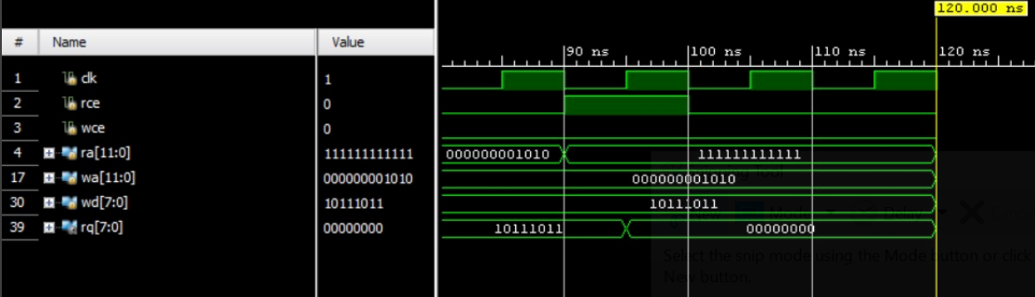
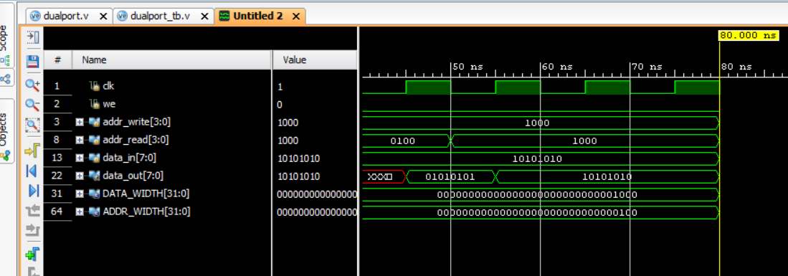
Implementation and Results – Iteration 3
Iteration : Results(Verilog) + Validation against the use cases and test cases
DRAM waveform
DualPort RAM waveform

Slide 12
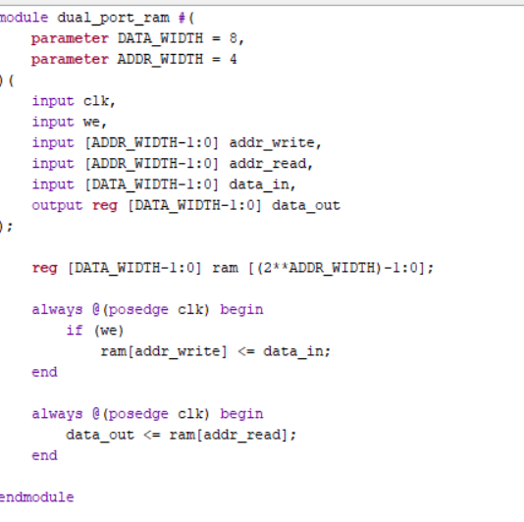
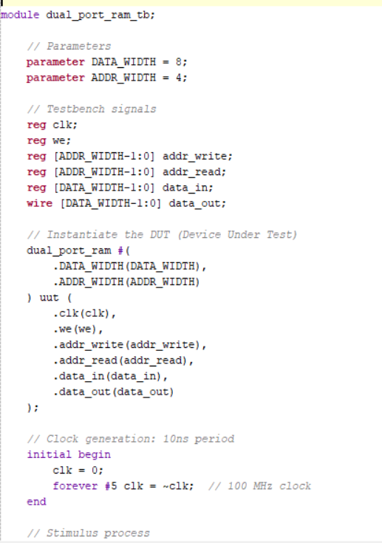
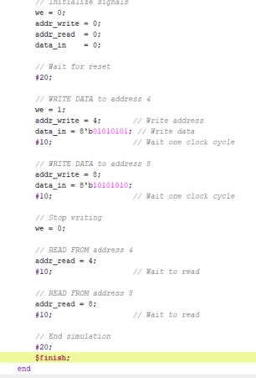
Implementation and Results – Iteration 3
Iteration : Results + Validation against the use cases and test cases
Dual Port RAM Verilog code Testbench code

Slide 13
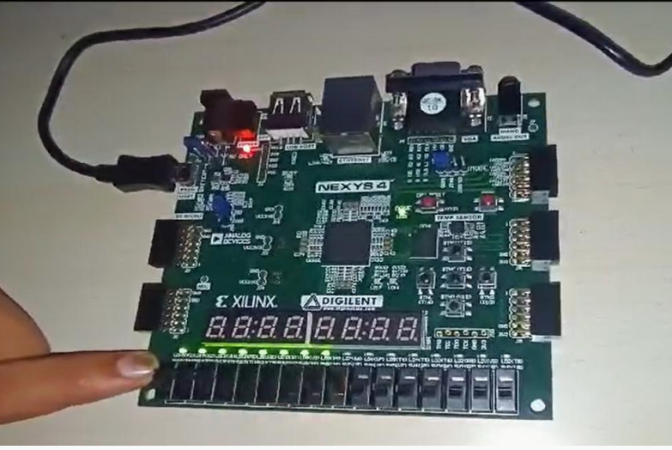
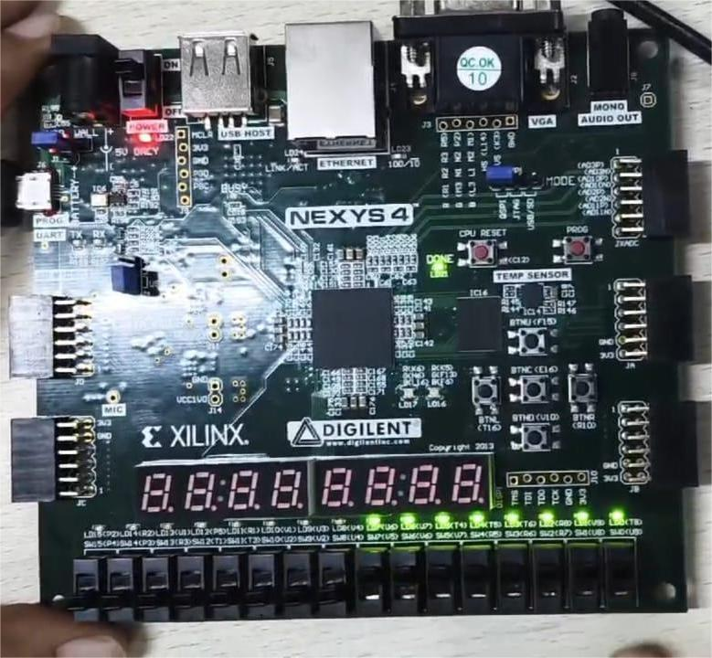
Implementation and Results – Iteration 3
Iteration : Hardware FPGA Implementation(Verilog)
RAM
DualPort RAM

Slide 14
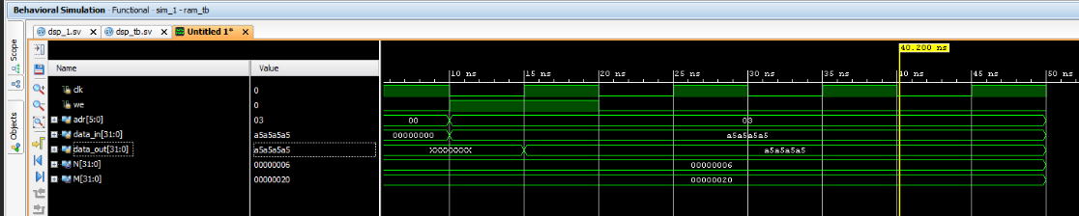
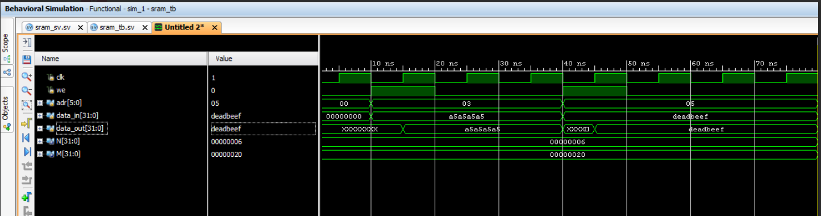
Implementation and Results – Iterarion 1
Iteration : Results (SystemVerilog)
RAM waveform
SRAM waveform

Slide 15
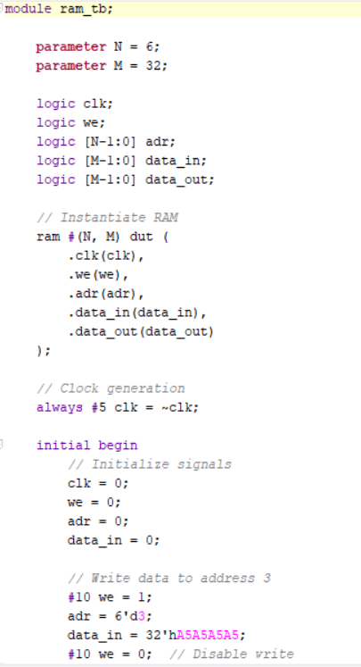
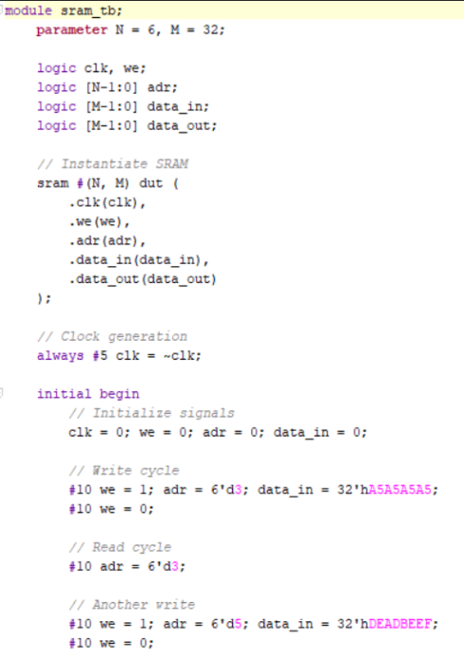
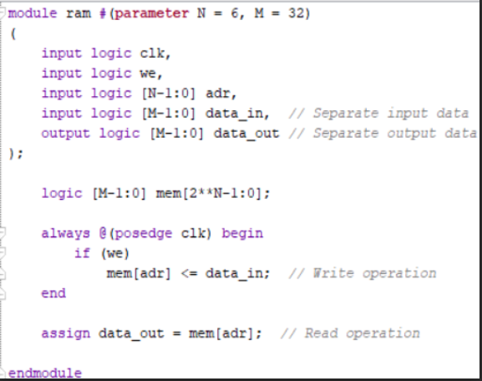
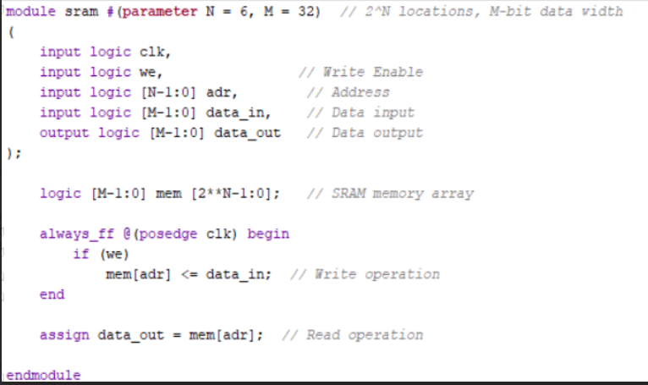
Implementation and Results – Iterarion 1
Iteration : Results
RAM code
SRAM Code

Slide 16
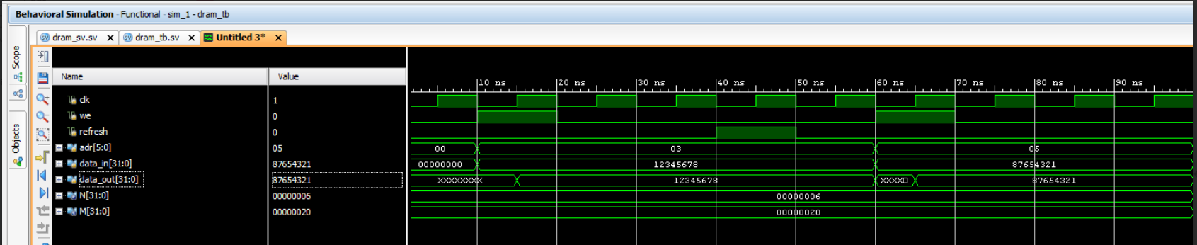
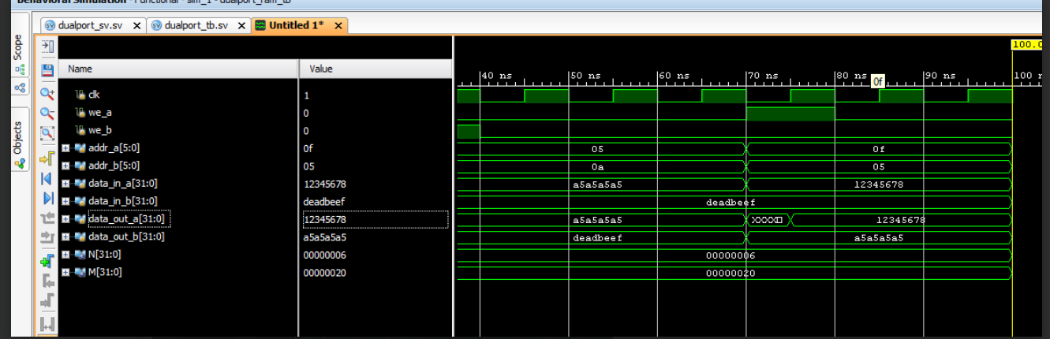
Implementation and Results – Iterarion 2
Iteration : Results
DRAM wavewform
DualPort RAM wavewform

Slide 17
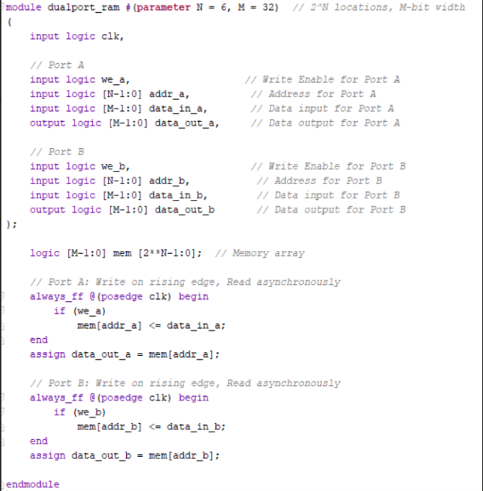
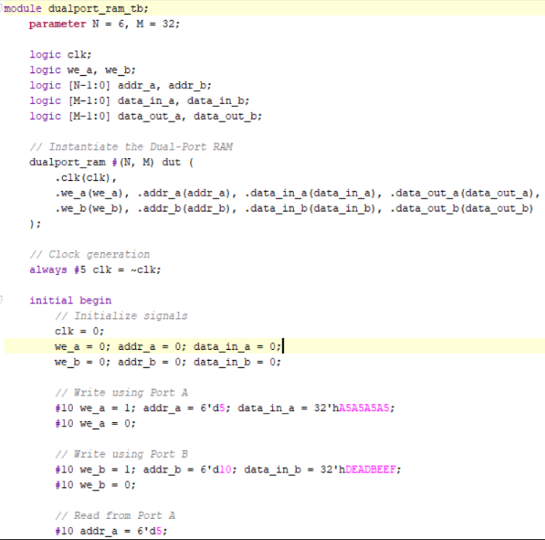
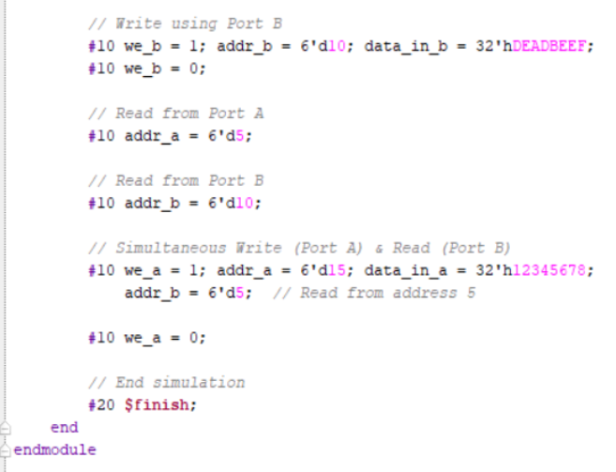
Implementation and Results – Iteration 3
Iteration : Results+ Validation against the use cases and test cases
DualPort RAM code
Testbench

Slide 18
Contribution
Team Progress and Movement
Completed Implementatiuon Of RAM and DualPort RAM on FPGA.
Completed Implementation of RAM,SRAM,DRAM, Dual Port RAM in Sytem Verilog(Vivado).
Individual Contribution
Key contributions: C SanthiPriya
Software Implementation of RAM,SRAM,Dual Port RAM
Documentation on Xilinx Vivado
Hardware Implementation
Key contributions: Pranitha M
Documentation
Software Implementation of RAM,SRAM,Dual Port RAM on Xilinx Vivado
Key contributions: N Keerthi
Documentation
Software Implementation of RAM,SRAM,Dual Port RAM on Xilinx Vivado

Slide 19
Conclusion & Future Work
Summary and Conclusion
A memory architecture allowing simultaneous access to two independent ports for read and write operations, improving performance in parallel processing applications.
The RAM,SRAM,DRAM,Dual Port RAM was implemented using System Verilog for hardware description.
System Verilog testbenches were utilized for functional verification.
The design was synthesized and implemented on an FPGA to validate its functionality, ensuring proper timing, area, and power optimization.
System Verilog-driven testbenches provided extensive validation.
Test cases included boundary condition checks, simultaneous read-write operations, and fault injections.
Conclusion:
The project successfully implemented a reliable and efficient RAM on FPGA.
System Verilog-driven testbenches ensured the design met functional and performance requirements.
The RAM architecture is scalable for larger memory modules and adaptable to various FPGA platforms.
Future Work
We aim to utilize advanced SystemVerilog features for design and verification.
Future work will explore enhanced methodologies and tools within SystemVerilog.

Slide 20
THANK YOU
Have a Great Day !

